Slide 1
IDR Senior Design 2
Team Lead: Steven Wang

Slide 2
Deliverables
Test 1 Design
Test 1 Schematic
FMEA
Design Correction
Test design timeline
BOM
Purchase Parts

Slide 3
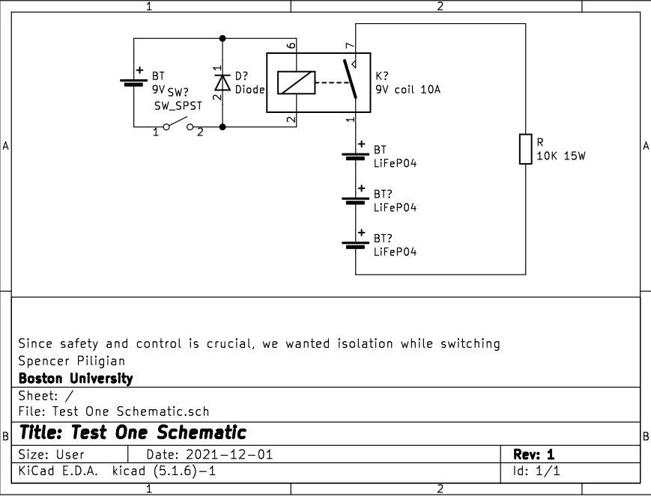
Test 1 Schematic

Slide 4
FMEA
Failures | Severity | Occurrence | Detection | RPN | Correction
Short in Ckt | 9 | 3 | 1 | 27 | Fuse Relay
Overloading wires | 8 | 1 | 5 | 40 | Good wire ratings
Bad battery connection | 4 | 7 | 1 | 28 | Reliable battery holder Good terminals
Overheating | 6 | 4 | 1 | 24 | Live temp. sensor
Switch failure | 2 | 1 | 1 | 2 | N/A
Environmental | 3 | 1 | 1 | 3 | N/A

Slide 5
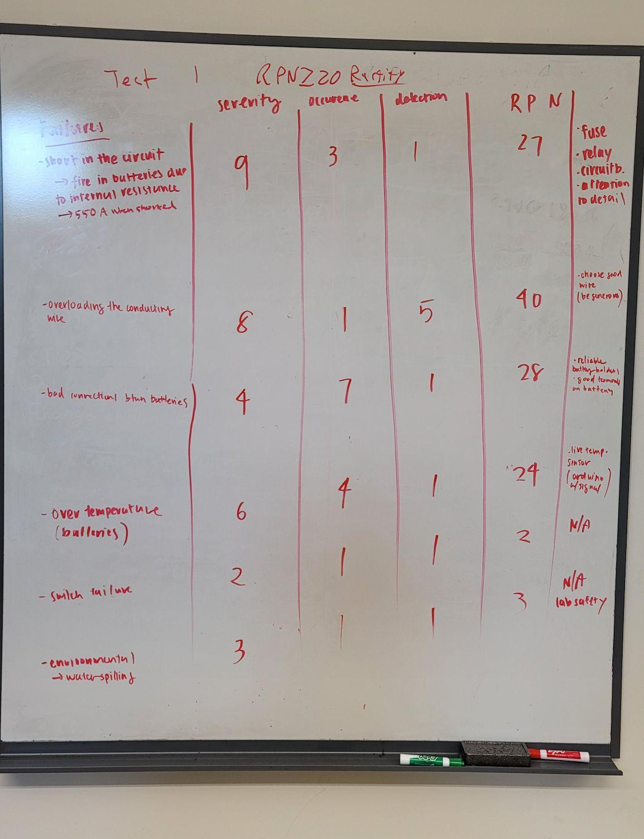

Slide 6
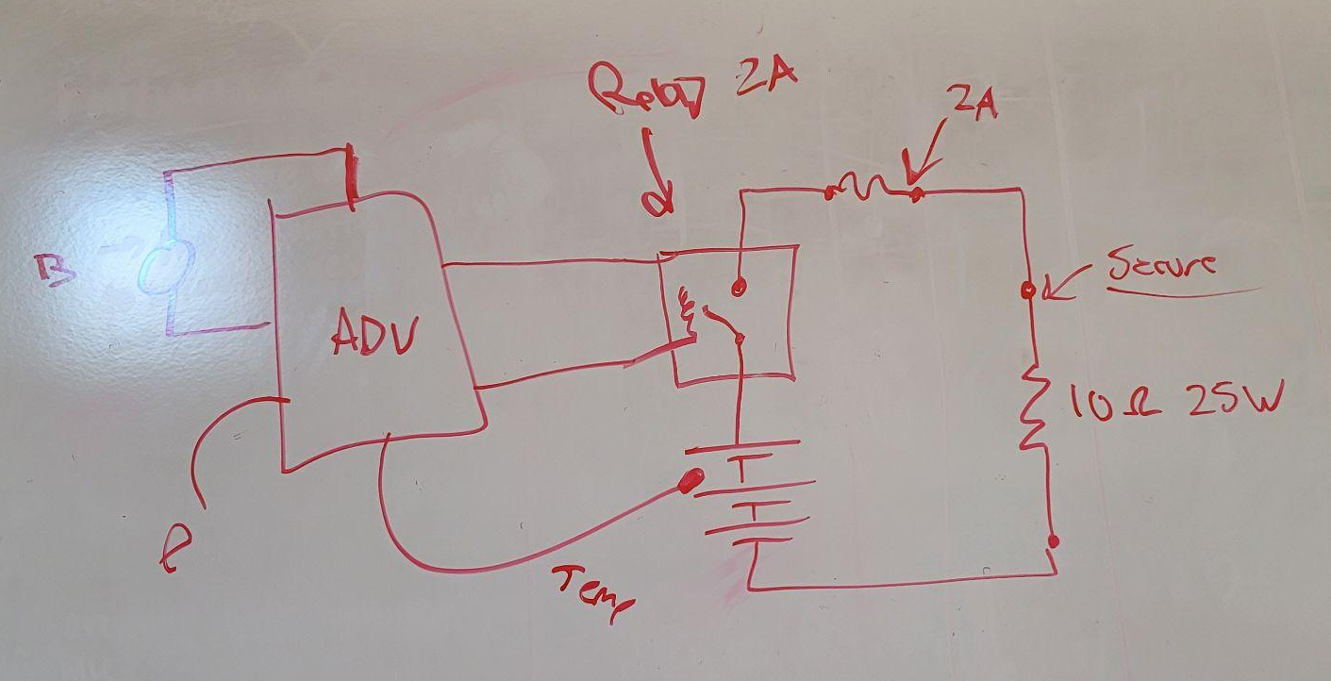
FMEA Design Correction

Slide 7
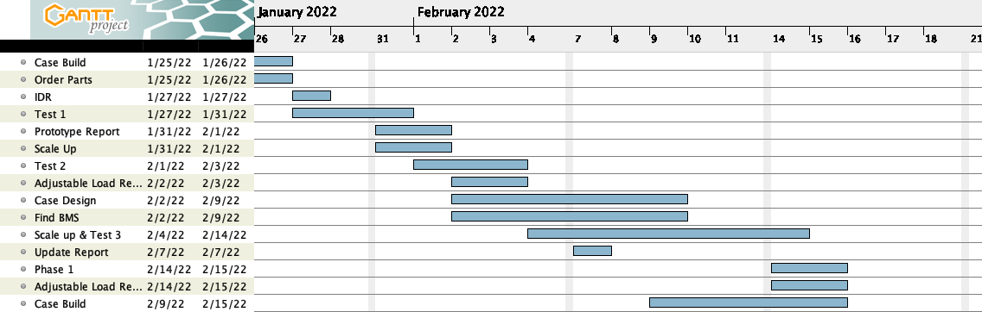
Timeline

Slide 8
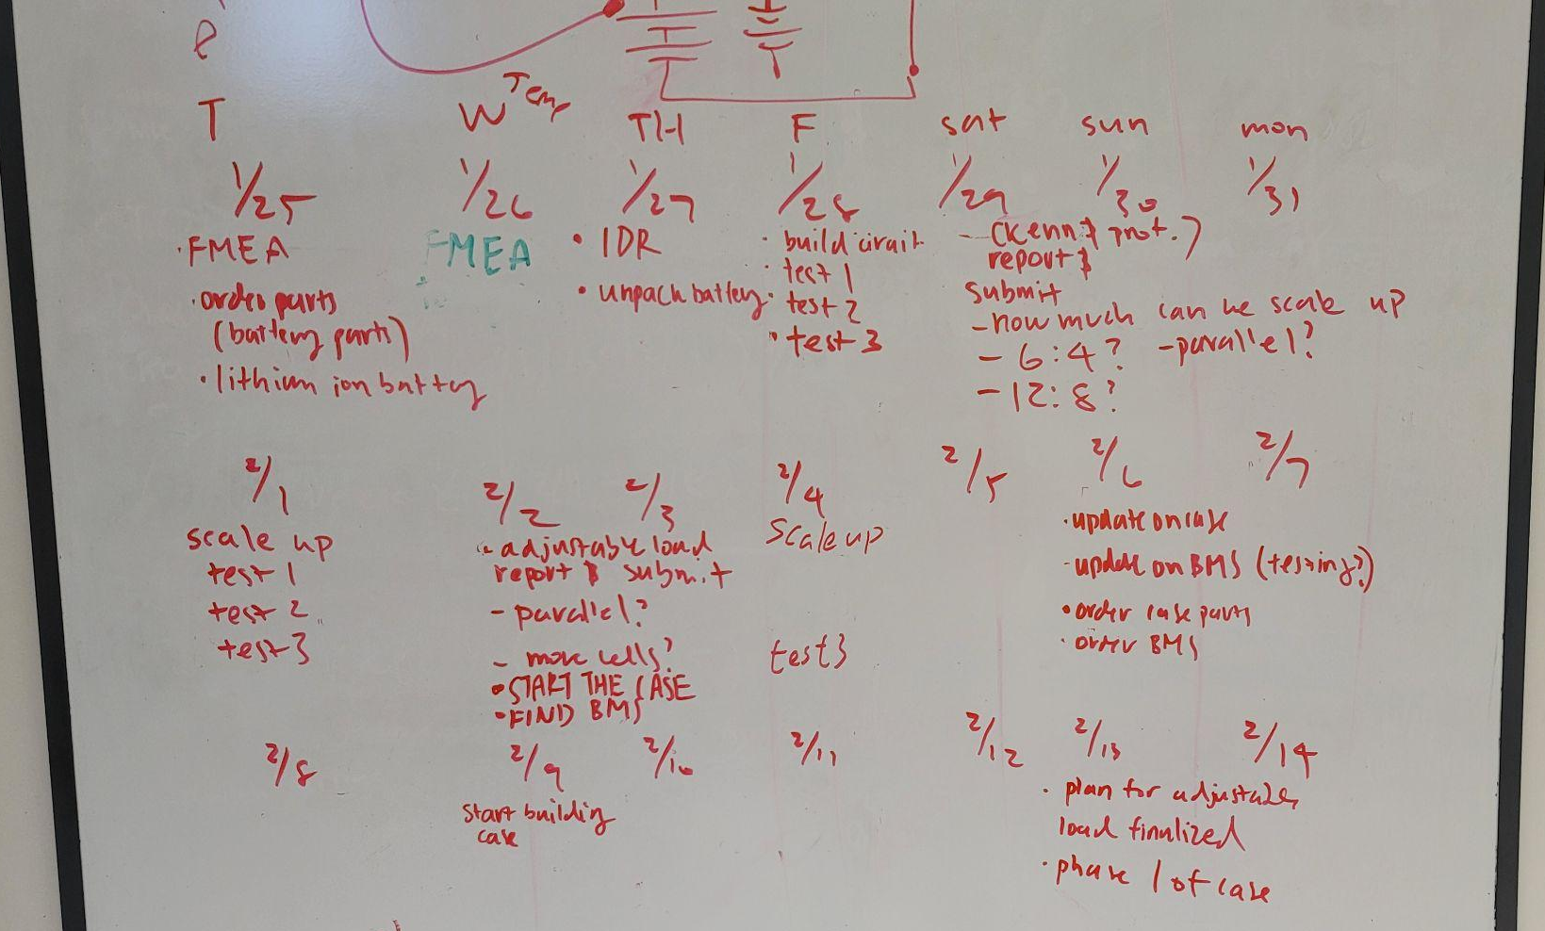

Slide 9
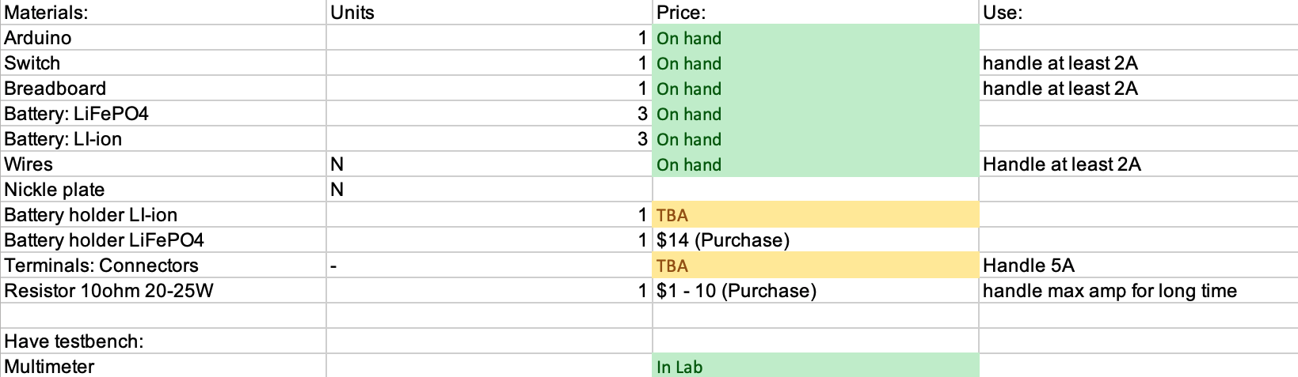
Bill of Materials (Test 1)

